Slide 1


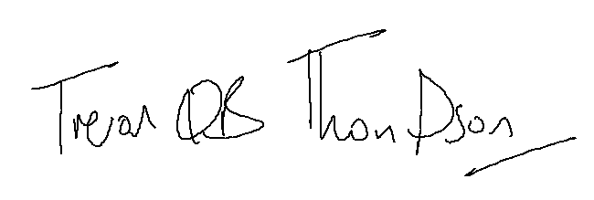
Teaching Practice
Dr Trevor Thompson
Head of Primary Care Teaching

Slide 2


We teach medical students
This practice is proud to be a University of Bristol teaching practice, which means that we sometimes have medical students here on placement.
If there is a medical student sitting in your consultation, we will let you know before hand. Sometimes students may see you on their own, but you will always be reviewed by a qualified health professional afterwards. If you would prefer not to see a student at all, please let the receptionist know.
Students learn a huge amount from this experience and most patients find it helpful too.
We can’t do it without you!
Dr Trevor Thompson
Head of Primary Care Teaching

